Slide 1
ULTRASOUND DISTANCE DETECTION
A Project By Kieran Small

Slide 2
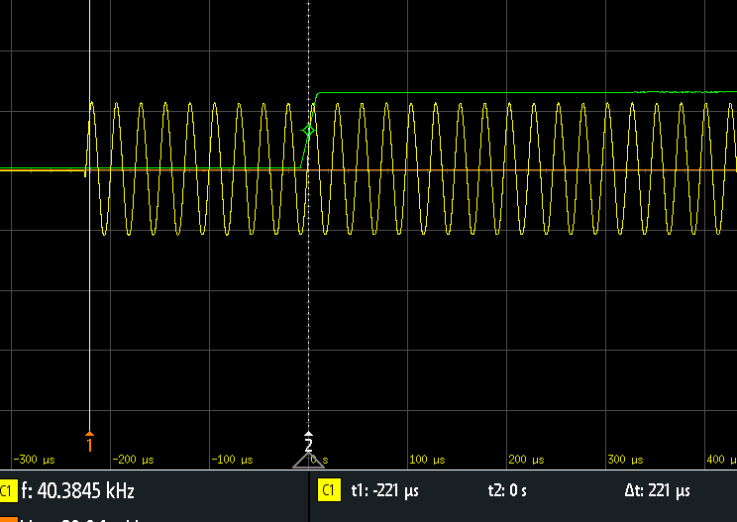
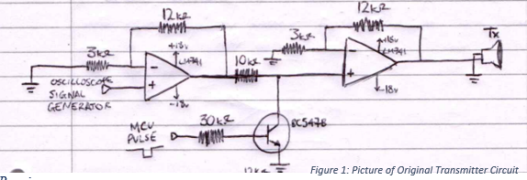
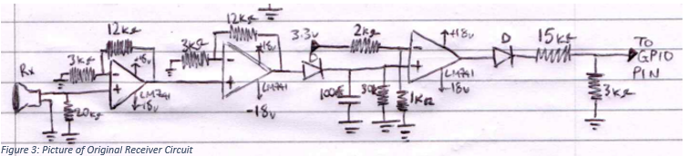
Initial Circuit and Testing

Slide 3
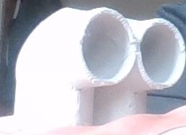
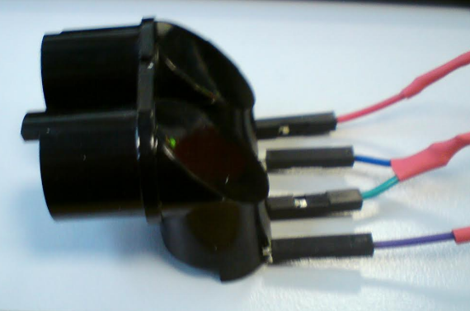
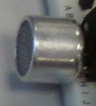
Issue 1: Directing The Signal

Slide 4
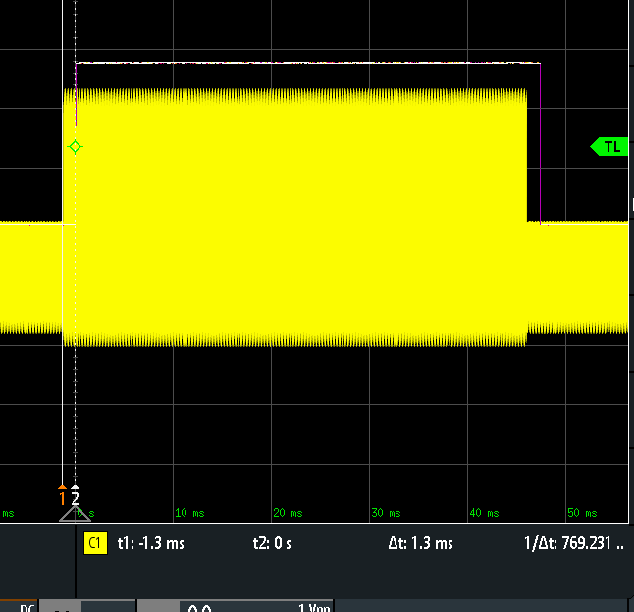
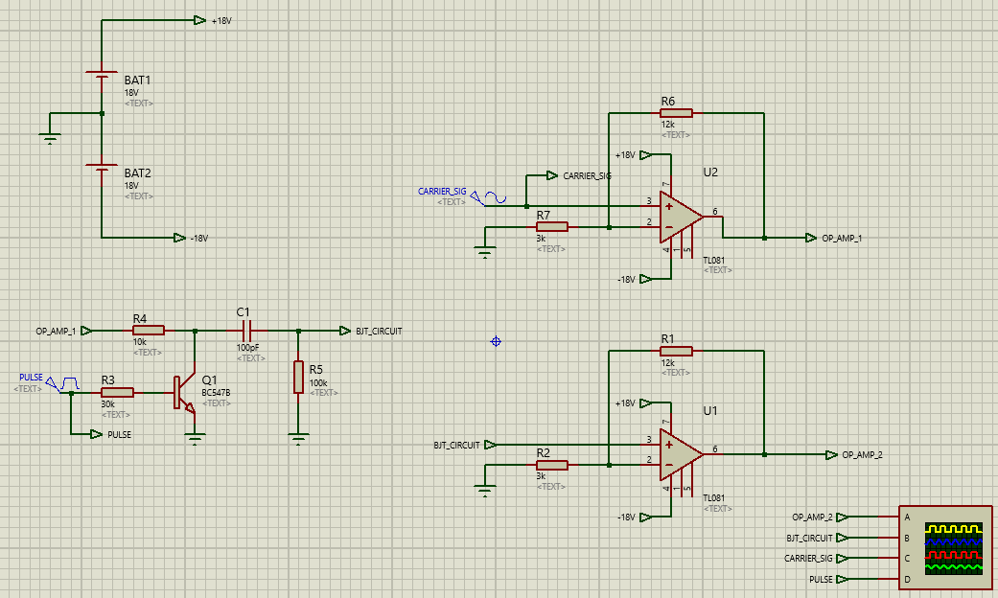
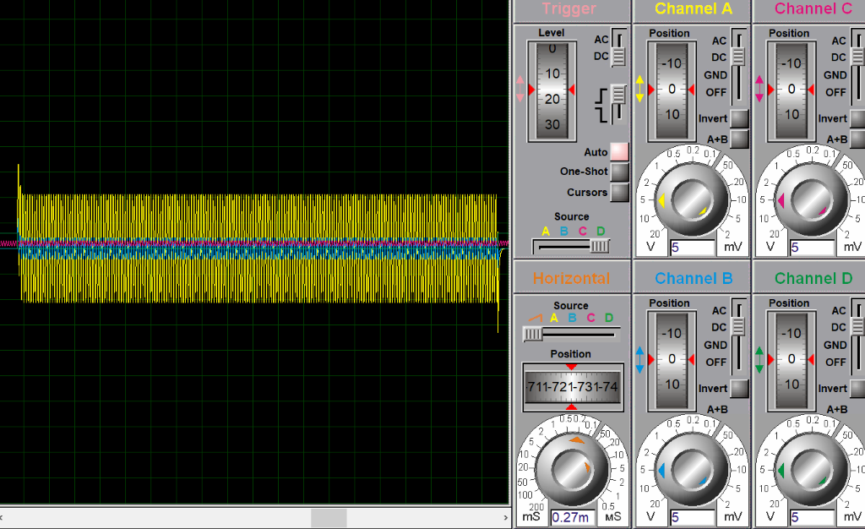
Issue 2: The Noise Floor

Slide 5
Issue 3: Finding a Constant point on the received signal to stop the time measurement

Slide 6
Variable Threshold Voltage

Slide 7
Error Correction Code

Slide 8
Speed Calculations Depending on Temperature

Slide 9
Future Developments
- Adaptive Gain - Moving Objects - Transducer Arrays

Slide 10
Management

Slide 11
Thank You, Any Questions?

